Slide 1
State of the Art, Research Questions and Milestones
Sharan Krishnan

Slide 2
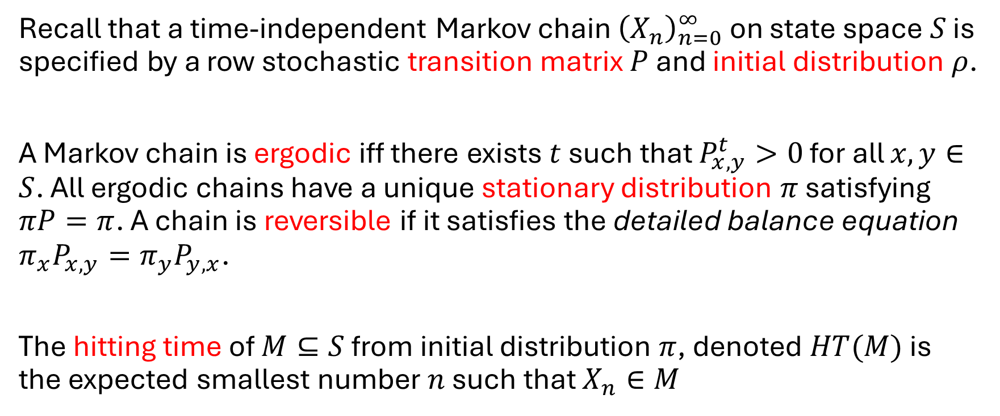
Preliminaries
Recall that a time-independent Markov chain ${\left(X_{n}\right)}_{n=0}^{∞}$ on state space $S$ is specified by a row stochastic transition matrix $P$ and initial distribution $ρ$.
A Markov chain is ergodic iff there exists $t$ such that $P_{x,y}^{t}>0$ for all $x,y∈S$. All ergodic chains have a unique stationary distribution $π$ satisfying $πP=π$. A chain is reversible if it satisfies the detailed balance equation $π_{x}P_{x,y}=π_{y}P_{y,x}$.
The hitting time of $M⊆S$ from initial distribution $π$, denoted $HT(M)$ is the expected smallest number $n$ such that $X_{n}∈M$

Slide 3
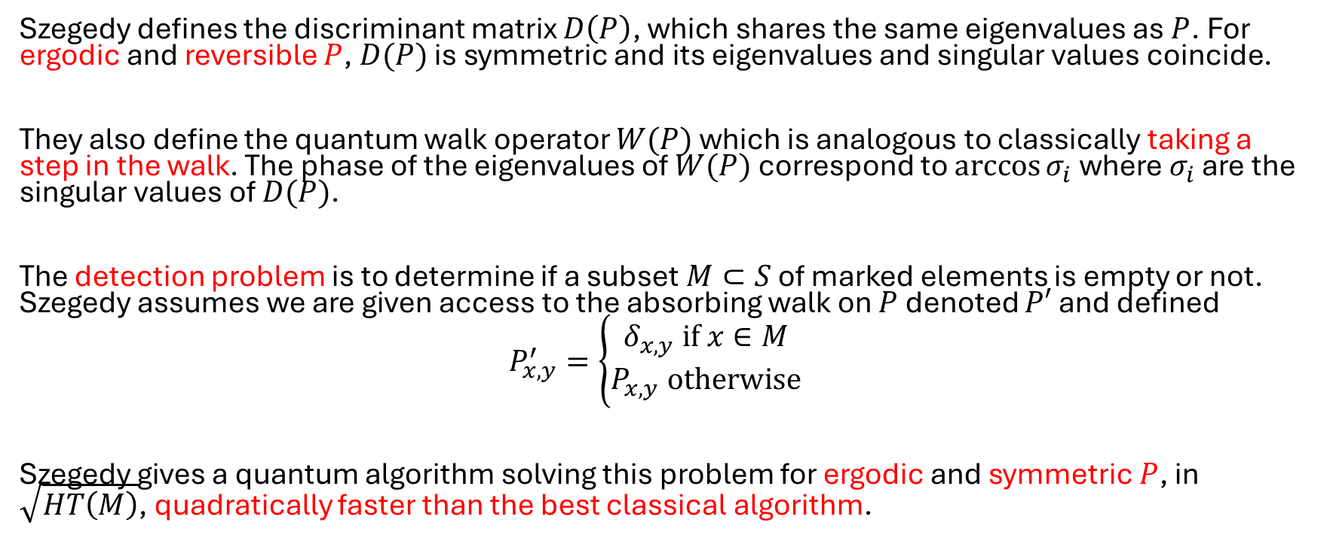
Quantum Speedup of Markov Chain Based Algorithms (Szegedy, 2004)
Szegedy defines the discriminant matrix $D\left(P\right)$, which shares the same eigenvalues as $P$. For ergodic and reversible $P$, $D(P)$ is symmetric and its eigenvalues and singular values coincide.
They also define the quantum walk operator $W(P)$ which is analogous to classically taking a step in the walk. The phase of the eigenvalues of $W(P)$ correspond to $\arccos{σ_{i}}$ where $σ_{i}$ are the singular values of $D(P)$.
The detection problem is to determine if a subset $M⊂S$ of marked elements is empty or not. Szegedy assumes we are given access to the absorbing walk on $P$ denoted $P′$ and defined
$$P_{x,y}^{′}=\left\{\begin{aligned}δ_{x,y} if x∈M \\ P_{x,y} otherwise\end{aligned}\right.$$
Szegedy gives a quantum algorithm solving this problem for ergodic and symmetric $P$, in $\sqrt{HT\left(M\right)}$, quadratically faster than the best classical algorithm.

Slide 4
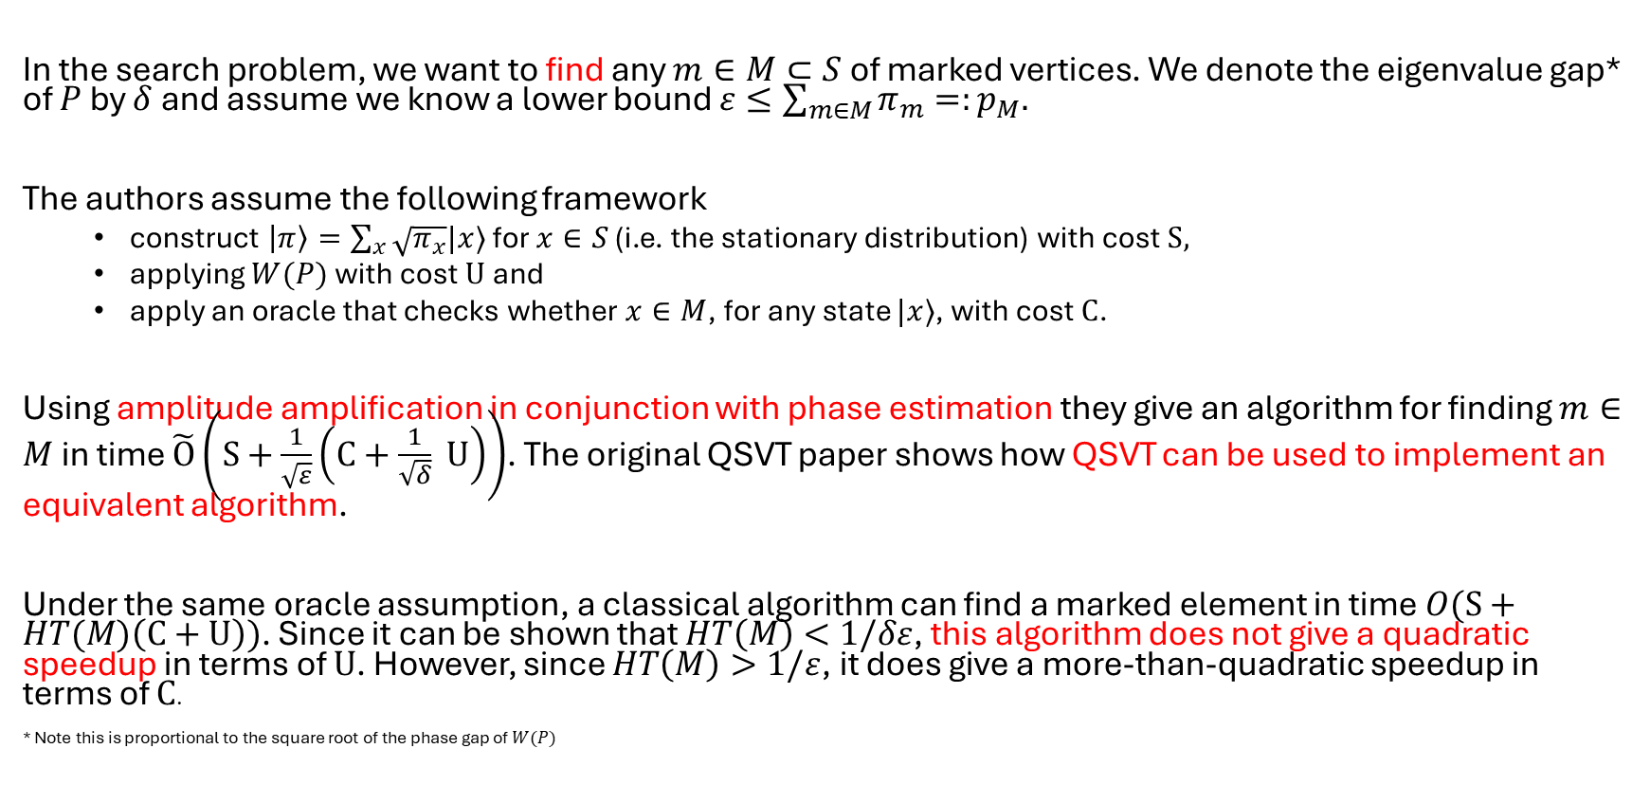
Search via Quantum Walk (MNRS, 2011)
In the search problem, we want to find any $m∈M⊂S$ of marked vertices. We denote the eigenvalue gap* of $P$ by $δ$ and assume we know a lower bound $ε≤\sum_{m∈M}{π_{m}}=:p_{M}.$
The authors assume the following framework
construct $\left|π\right\rangle =\sum_{x}{\sqrt{π_{x}}|x⟩}$ for $x∈S$ (i.e. the stationary distribution) with cost $S,$
applying $W(P)$ with cost $U$ and
apply an oracle that checks whether $x∈M$, for any state $|x⟩$, with cost $C$.
Using amplitude amplification in conjunction with phase estimation they give an algorithm for finding $m∈M$ in time $\tilde{O}\left(S+\frac{1}{\sqrt{ε}}\left(C+\frac{1}{\sqrt{δ}} U\right)\right)$. The original QSVT paper shows how QSVT can be used to implement an equivalent algorithm.
Under the same oracle assumption, a classical algorithm can find a marked element in time $O(S+HT(M)\left(C+U\right))$. Since it can be shown that $HT\left(M\right)<1/δε$, this algorithm does not give a quadratic speedup in terms of $U$. However, since $HT\left(M\right)>1/ε$, it does give a more-than-quadratic speedup in terms of $C$.
* Note this is proportional to the square root of the phase gap of $W(P)$

Slide 5
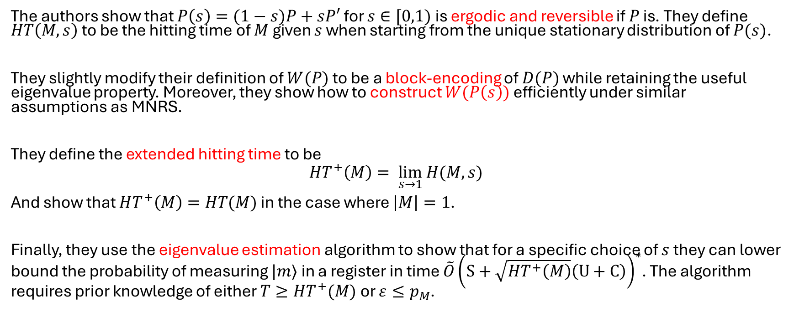
Quantum Walks Can Find a Marked Element on Any Graph (KMOR, 2016)
The authors show that $P\left(s\right)=(1−s)P+sP′$ for $s∈[0,1)$ is ergodic and reversible if $P$ is. They define $HT\left(M,s\right)$ to be the hitting time of $M$ given $s$ when starting from the unique stationary distribution of $P(s)$.
They slightly modify their definition of $W(P)$ to be a block-encoding of $D(P)$ while retaining the useful eigenvalue property. Moreover, they show how to construct $W(P\left(s\right))$ efficiently under similar assumptions as MNRS.
They define the extended hitting time to be
$$HT^{+}\left(M\right)= \lim_{s→1} H(M,s)⁡$$
And show that $HT^{+}\left(M\right)=HT(M)$ in the case where $\left|M\right|=1$.
Finally, they use the eigenvalue estimation algorithm to show that for a specific choice of $s$ they can lower bound the probability of measuring $|m⟩$ in a register in time $\tilde{O}{\left(S+\sqrt{HT^{+}\left(M\right)}\left(U+C\right)\right)}^{∗}$. The algorithm requires prior knowledge of either $T≥HT^{+}(M)$ or $ε≤p_{M}$.

Slide 6
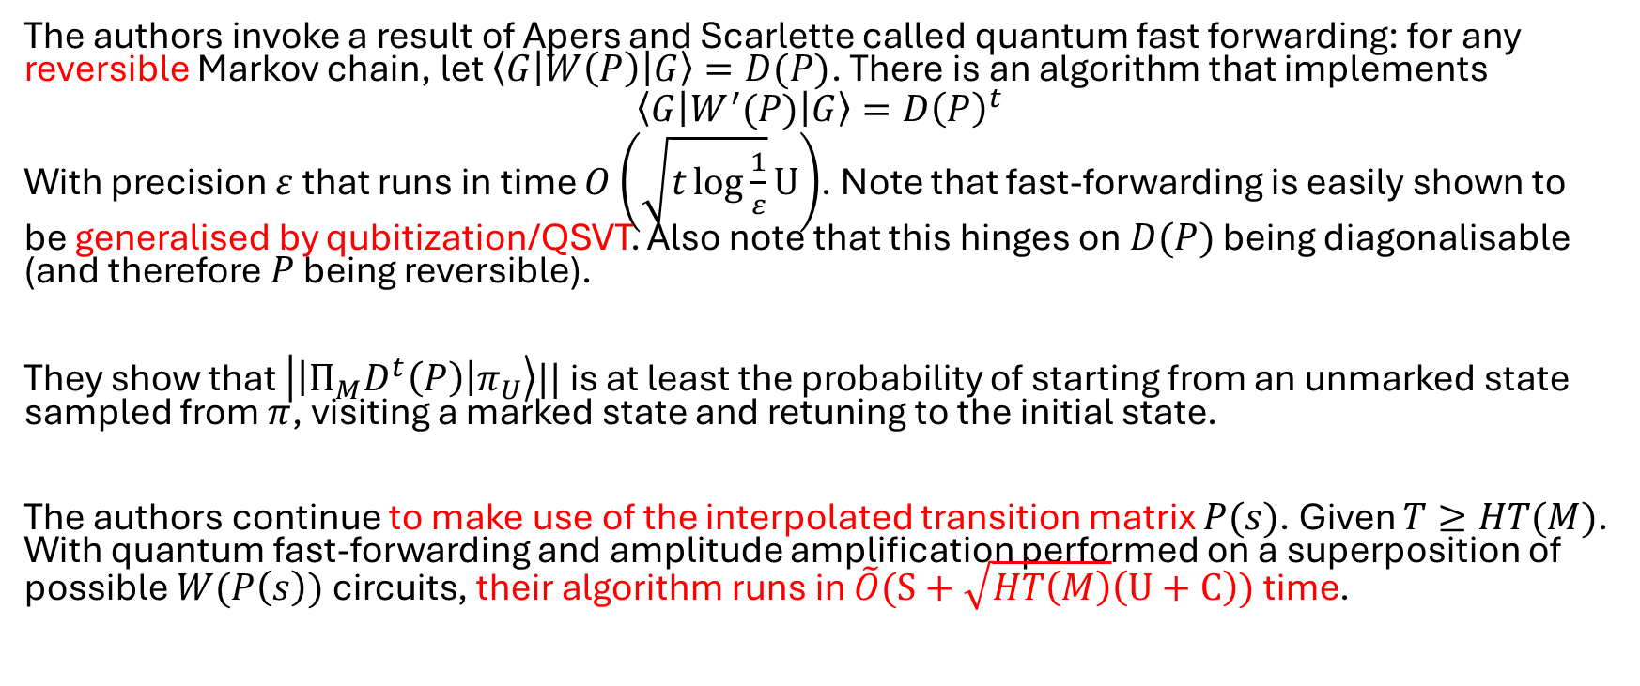
Quadratic speedup for Finding Marked Vertices by Quantum Walks (AGJK, 2020)
The authors invoke a result of Apers and Scarlette called quantum fast forwarding: for any reversible Markov chain, let $\left\langle G\left|W\left(P\right)\right|G\right\rangle =D(P)$. There is an algorithm that implements
$$\left\langle G\left|W^{′}(P)\right|G\right\rangle =D{\left(P\right)}^{t}$$
With precision $ε$ that runs in time $O\left(\sqrt{t\log{\frac{1}{ε}}}U\right)$. Note that fast-forwarding is easily shown to be generalised by qubitization/QSVT. Also note that this hinges on $D(P)$ being diagonalisable (and therefore $P$ being reversible).
They show that $\left|\left|Π_{M}D^{t}\left(P\right)\right|π_{U}\right\rangle ||$ is at least the probability of starting from an unmarked state sampled from $π$, visiting a marked state and retuning to the initial state.
The authors continue to make use of the interpolated transition matrix $P(s)$. Given $T≥HT(M)$. With quantum fast-forwarding and amplitude amplification performed on a superposition of possible $W(P\left(s\right))$ circuits, their algorithm runs in $\tilde{O}(S+\sqrt{HT\left(M\right)}\left(U+C\right))$ time.

Slide 7
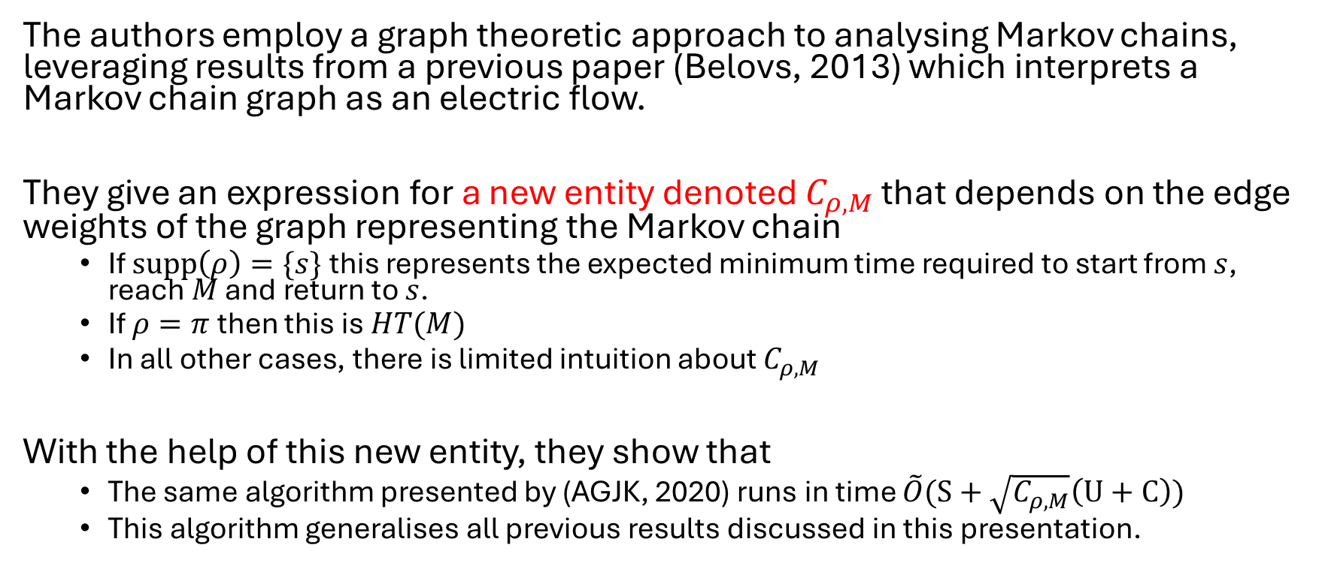
A Unified Framework of Quantum Walk Search (AGJ, 2019)
The authors employ a graph theoretic approach to analysing Markov chains, leveraging results from a previous paper (Belovs, 2013) which interprets a Markov chain graph as an electric flow.
They give an expression for a new entity denoted $C_{ρ,M}$ that depends on the edge weights of the graph representing the Markov chain
If $supp\left(ρ\right)=\{s\}$ this represents the expected minimum time required to start from $s$, reach $M$ and return to $s$.
If $ρ=π$ then this is $HT(M)$
In all other cases, there is limited intuition about $C_{ρ,M}$
With the help of this new entity, they show that
The same algorithm presented by (AGJK, 2020) runs in time $\tilde{O}(S+\sqrt{C_{ρ,M}}\left(U+C\right))$
This algorithm generalises all previous results discussed in this presentation.

Slide 8
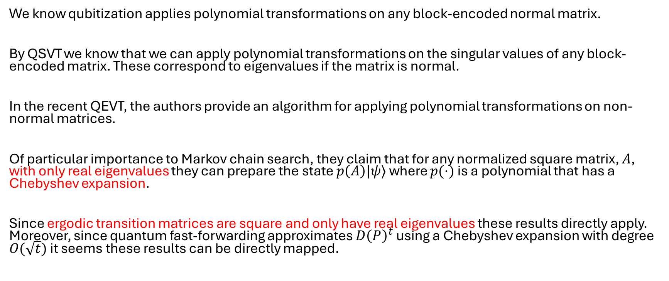
Quantum EigenValue Transformation (LS 2024)
We know qubitization applies polynomial transformations on any block-encoded normal matrix.
By QSVT we know that we can apply polynomial transformations on the singular values of any block-encoded matrix. These correspond to eigenvalues if the matrix is normal.
In the recent QEVT, the authors provide an algorithm for applying polynomial transformations on non-normal matrices.
Of particular importance to Markov chain search, they claim that for any normalized square matrix, $A$, with only real eigenvalues they can prepare the state $p\left(A\right)|ψ⟩$ where $p(⋅)$ is a polynomial that has a Chebyshev expansion.
Since ergodic transition matrices are square and only have real eigenvalues these results directly apply. Moreover, since quantum fast-forwarding approximates $D{\left(P\right)}^{t}$ using a Chebyshev expansion with degree $O(\sqrt{t})$ it seems these results can be directly mapped.

Slide 9
QSVT without block encodings (CHLSWZ, 2025)

Slide 10
Research Questions
Can reformulating quantum walk search through the framework of QSVT, or its extensions, yield speedups or reduce space requirements?
Can reformulating quantum walks through the framework of QSVT, or its extensions, yield a search algorithm for general (possibly non-reversible) ergodic Markov chains that exhibits a speedup compared to classical search?

Slide 11
Milestones
Gain a deep understanding of the proofs and implications of the papers discussed in this presentation with (perhaps) the exception of (Szegedy, 2004) and (MNRS, 2011)
Give end-to-end QSVT generalisations for each of the search algorithm variants. Assess if there are speedups or generalisations that automatically apply
Repeat the previous milestone for QEVT and QSVT without block encodings.
Verify that QEVT generalises the results of quantum fast forwarding to non-normal ergodic matrices
If no speedups/generalisations have been found, assess why.

Slide 12
Proposal structure
Expected word count = 6000
Introduction (~800 words)
Importance of random walk search algorithms
Broad overview of quantum walk search algorithms, the advantage it has over classical algorithms and its limitations
Broad overview of QSVT, how it generalizes much of existing quantum algorithms and how numerous recent work extends its utility.
How a gap exists in applying extensions of QSVT to quantum walk search algorithms to offer potential speedups and generalizations.
Preliminaries (~700 words)
Introduction to Markov chains and key properties/definitions
Introduction to quantum computing including: postulates of quantum mechanics; quantum circuits, circuit depth and query complexity; and eigenvalue and singular value decompositions.
Literature review (~3000 words)
Review of quantum walk algorithms (~1500 words) with a specific focus on search, from Ambainis’ original element distinctness algorithm to quadratic speedup of marked vertex search.
Review of QSVT (~1500 words) starting from motivation in NMR, to Isaac Chuang’s characterization of achievable polynomials in two-dimensional space all the way to recent discoveries in quantum eigenvalue transformation.
Justification of research questions (~500 words)
Research Milestones (~1000 words)
Research timeline (~0 words)

Slide 13
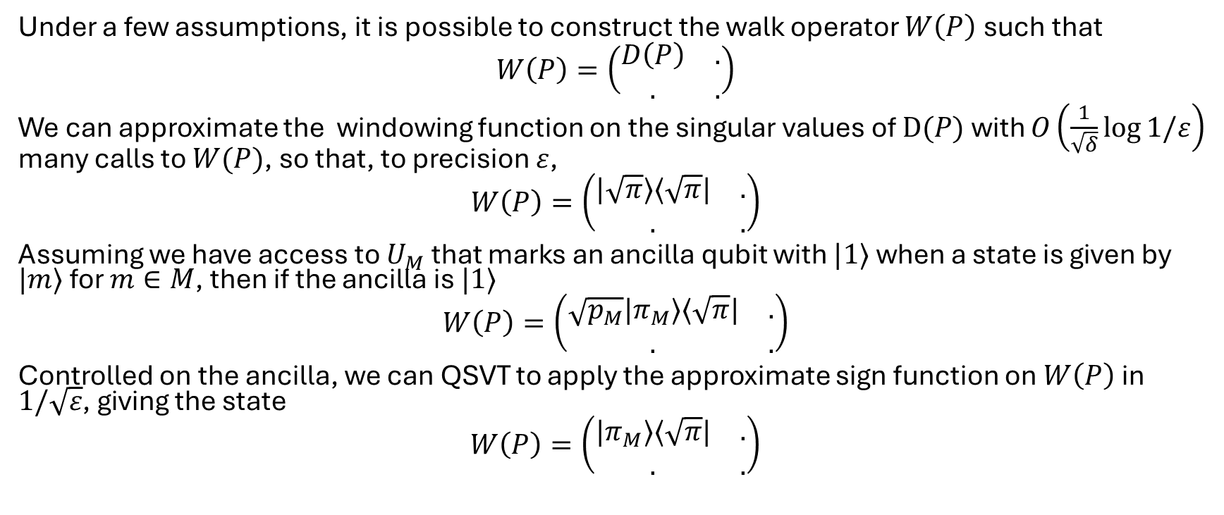
Search via Quantum Walks recap II
Under a few assumptions, it is possible to construct the walk operator $W\left(P\right)$ such that
$$W\left(P\right)=\left(\begin{matrix}D\left(P\right) & . \\ . & .\end{matrix}\right)$$
We can approximate the windowing function on the singular values of $D(P)$ with $O\left(\frac{1}{\sqrt{δ}}\log{1/ε}\right)$ many calls to $W(P)$, so that, to precision $ε$,
$$W\left(P\right)=\left(\begin{matrix}|\sqrt{π}⟩⟨\sqrt{π}| & . \\ . & .\end{matrix}\right)$$
Assuming we have access to $U_{M}$ that marks an ancilla qubit with $|1⟩$ when a state is given by $|m⟩$ for $m∈M$, then if the ancilla is $|1⟩$
$$W\left(P\right)=\left(\begin{matrix}\sqrt{p_{M}}|π_{M}⟩⟨\sqrt{π}| & . \\ . & .\end{matrix}\right)$$
Controlled on the ancilla, we can QSVT to apply the approximate sign function on $W\left(P\right)$ in $1/\sqrt{ε}$, giving the state
$$W\left(P\right)=\left(\begin{matrix}|π_{M}⟩⟨\sqrt{π}| & . \\ . & .\end{matrix}\right)$$

